Slide 1


Pizza Sales
Data Science Project
By : Siddharth Rawat

Slide 2
Introduction
Pizza is one of the most popular foods worldwide, with millions of pizzas being sold every day. As a result, understanding the pizza industry and its trends can provide valuable insights for businesses and researchers alike. This dataset on pizza sales offers a comprehensive look at pizza sales trends, including information on sales volume, revenue, and customer preferences. The dataset includes data from various pizza restaurants and chains, both large and small, across different regions and time periods.

Slide 3
Details of Data
pizza_id: A unique identifier assigned to each distinct pizza variant available for ordering.
order_id: A unique identifier for each order made, which links to multiple pizzas.
pizza_name_id: An identifier linking to a specific name of the pizza.
quantity: The number of units of a specific pizza variant ordered within an order.
order_date: The date when the order was placed.
order_time: The time when the order was placed.
unit_price: The cost of a single unit of the specific pizza variant.
total_price: The aggregated cost of all units of a specific pizza variant in an order.
pizza_size: Represents the size of the pizza (e.g., small, medium, large).
pizza_category: Indicates the category of the pizza, such as vegetarian, non-vegetarian.
pizza_name: Specifies the name of the specific pizza variant ordered.non-vegetarian,

Slide 4
Main KPIs
Revenue - Total Revenue for the pizza.
AOV - Average Order Value.
TPS - Total Pizzas Sold .
TO - Total Orders.
Appo - Average Pizzas Per Order.

Slide 5
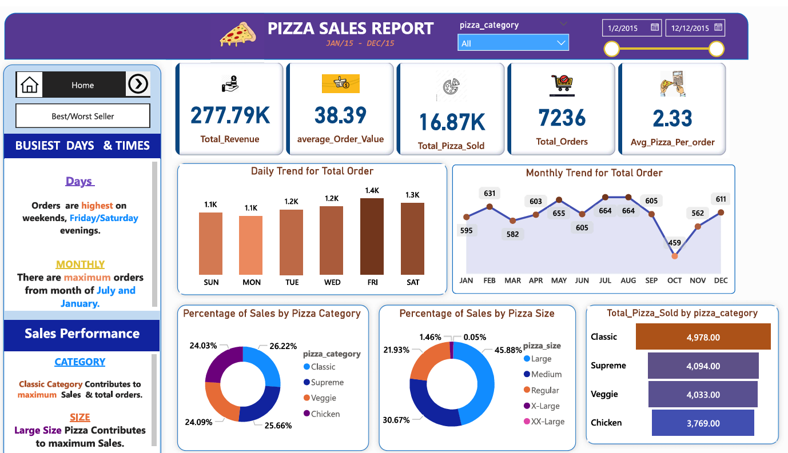

Slide 6
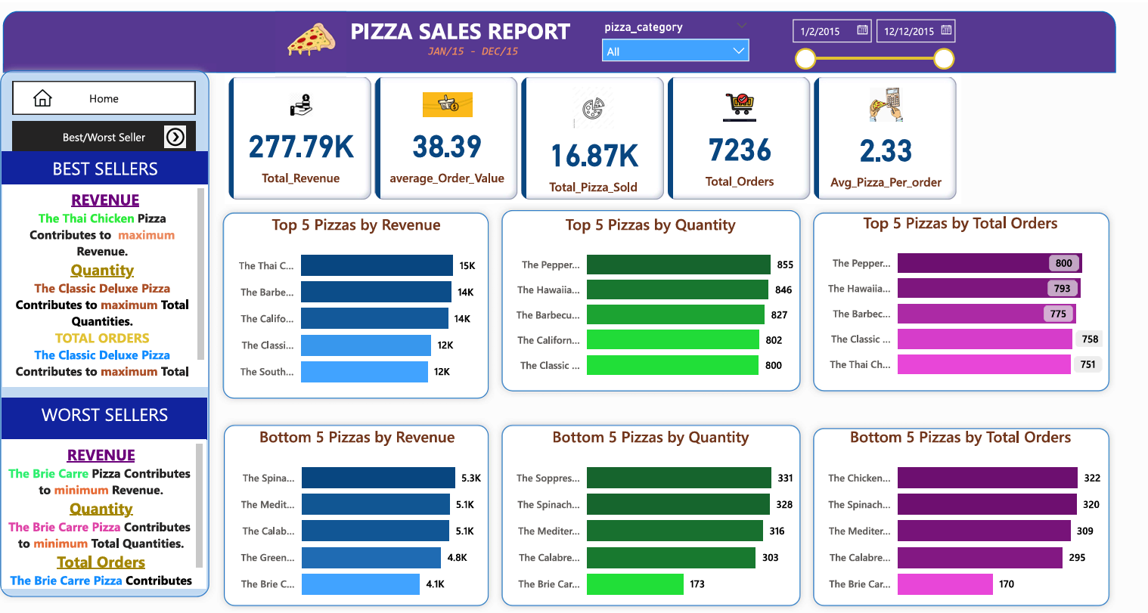

Slide 7
Conclusion
The analysis of the pizza sales data for 2015 has revealed some interesting trends and insights. The restaurant can use this information to make better marketing decisions and improve the customer experience. By understanding what pizzas are most popular and when pizza sales are highest, the restaurant can allocate its resources more effectively and boost its profits.
The analysis has also identified some specific problems that the restaurant can address. For example, the restaurant can increase pizza sales on weekdays for pizzas not currently selling well. The restaurant can improve its bottom line and continue to be a successful business by making these changes.

Slide 8
Thank You

